Slide 1
Computer Networks

Slide 2
Socket Programming

Slide 3
Agenda
What is Socket Programming.
Client-Server Model.
Socket Types.
Connection-Oriented: TCP.
Connectionless: UDP.
Example: Server says “Hello” to Client.

Slide 4
Where are we
Application Layer
HTTP/ HTTPS/ FTP/ SMTP
Transport Layer
TCP/ UDP
Network / Internet Layer
IP
Link Layer
Ethernet

Slide 5
The What
A collection of system calls (APIs) to write a networking program at user-level.
API is similar to file I/O in many respects: open, close, read, write.
Data written into socket on one host can be read out of socket on other host
The difference from files: networking has notion of client and server.
Notes:
API is short for application programming interface Sockets are created and used with a set of programming requests or "function calls" sometimes called the sockets application programming interface (API).

Slide 6
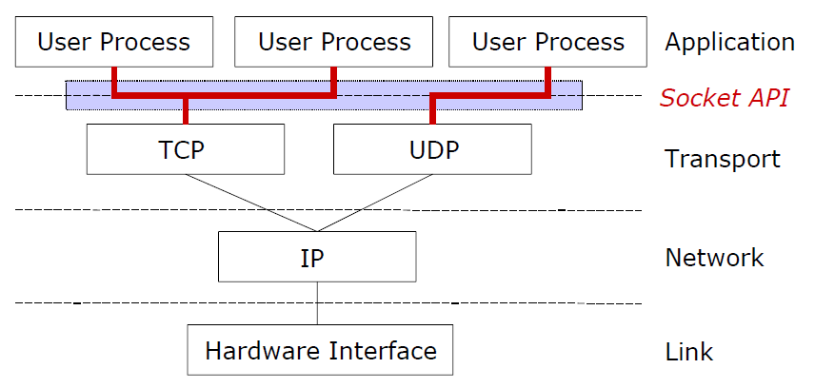
The What
Sockets functions between Transport Layer (TCP or UDP) and Application Layer (Your program)
Notes:
UDP similar to TCP but ignores reliability, fits things like video streaming, where you don’t care about correctness as much as you care about speed.
UDP is short for User Datagram Protocol

Slide 7
The What
In socket-based network programming, you do not directly access the network interface device to send and receive packets.
Instead, an intermediary file descriptor (Socket) is created to handle the programming interface to the network.

Slide 8
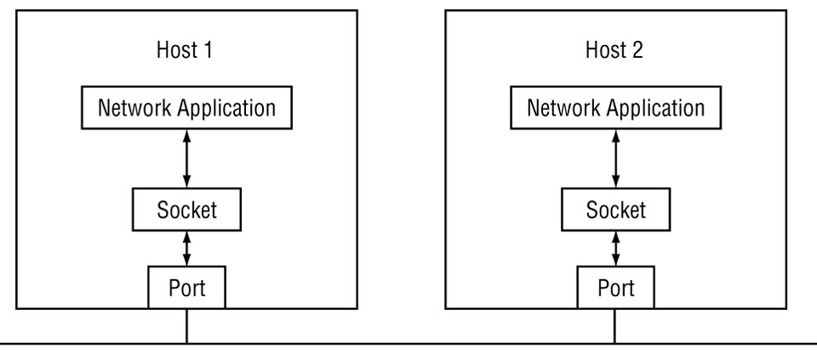
The What
After the socket is created, it must be bound to either a specific network address and port on the system, or to a remote network address and port. Once the socket is bound, it can be used to send and receive data from the network.

Slide 9
In a Nutshell
Sockets are interfaces that can "plug into" each other over a network. Once so "plugged in", the programs so connected communicate.

Slide 10
The Why
Allows inter-Process Communication: the capability of two or more physically connected machines to exchange data.

Slide 11
The How
A socket connection has 3 general parameters:
The protocol
Example: TCP, UDP etc.
The local and remote address
Example: 171.64.64.64
The local and remote port number
Needed to determine to which application packets are delivered
Some ports are reserved (e.g. 80 for HTTP)
Notes:
Port 25 for SMTP,
Port 20 and 21 For FTP,
Port 80 for HTTP

Slide 12
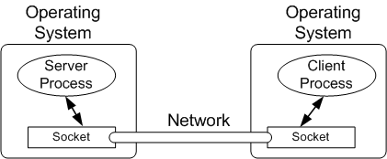
Client-Server Model
In the client-server model, the client runs a program to request a service and the server runs a program to provide the service.
These two programs communicate with each other using sockets.

Slide 13
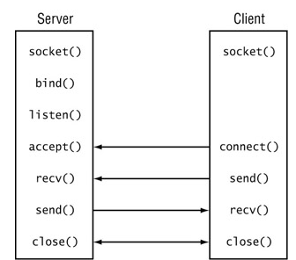
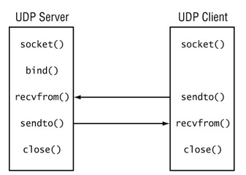
Socket Types
Two types of sockets:
Connection oriented
Connectionless

Slide 14
Connection Oriented
The TCP protocol is used to establish a session (connection) between two IP address endpoints.
There is a fair amount of overhead involved with establishing the connection, but once it is established, data can be reliably transferred between the devices.
To create a connection-oriented socket, separate sequences of functions must be used for server programs and for client programs
Notes:
There is a fair amount of overhead involved with establishing the connection??

Slide 15
Connectionless
The UDP protocol is used, no connection information is required to be sent between network devices.
The sender and receiver addresses will be specified in each send and receive function parameters.
Notes:
No handshaking

Slide 16
Sockets in .net

Slide 17
Sockets in .Net
The .NET Framework network classes were created to provide easy interfaces to the native Winsock network API for programmers using the .NET programming languages.
The System.Net.Sockets namespace contains the classes that provide the actual .NET interface to the low-level Winsock APIs.
Notes:
Winsock is an API that allows Windows-based applications to access the transport protocols.

Slide 18
Initiating Connection Oriented Socket
Socket object is created at both the client and server.
The socket object at the server waits for any client socket to connect.
When the client socket is accepted, sending and receiving calls are allowed.

Slide 19
Server says “Hello” to Client
SERVER
CLIENT
Setting Socket for Connection
Setting Socket for Connection
Bind
Listen
Connect
Accept
Send
Receive
Close
Close

Slide 20
Initiating Connection Oriented Socket
Server Functions
Client Functions
Bind(EndPoint address)
Listen(int backlog)
(After the Listen() method is performed, the server is ready to accept any incoming connections)
Backlog defines the number of connections that the system will queue.
Any attempts by clients beyond that number of waiting connections will be refused.
Accept()
Accept() method returns a new socket (client’s socket), which is then used for all communication calls for the connection
Connect(IPEndPoint serverAddress)
The Connect() method will block (wait) until the connection has been established.
Notes:
Bind(EndPoint): The address parameter must point to a valid IPEndPoint instance, which includes a local IP address and a port number
listen (backlog): The backlog parameter defines the number of connections that the system will queue
Any attempts by clients beyond that number of waiting connections will be refused. You should remember that specifying a large number here might have performance consequences for your server. Each pending connection attempt uses buffer space in the TCP buffer area. This means less buffer space available for sent and received packets.

Slide 21
Using Connection Oriented Socket
Server Functions
Client Functions
IPEndPoint iep = new IPEndPoint(IPAddress.Any, 8000);
// Or use 127.0.0.1 address that refers to local host
//8000 is the number of any free port
//use command netstat to find all used ports.
Socket newserver = new Socket(AddressFamily.InterNetwork, SocketType.Stream, ProtocolType.Tcp);
newserver.Bind(iep);
newserver.Listen(5);
Socket clientSock = newserver.Accept();
IPAddress host = IPAddress.Parse(“127.0.0.1");
//192.168.1.1 refers to the server
IPEndPoint hostEndpoint = new IPEndPoint(host, 8000);
Socket sock = new Socket(AddressFamily.InterNetwork, SocketType.Stream, ProtocolType.Tcp);
sock.Connect(hostEndpoint);
1
2
4
3
Notes:
Bind(EndPoint): The address parameter must point to a valid IPEndPoint instance, which includes a local IP address and a port number
listen (backlog): The backlog parameter defines the number of connections that the system will queue
Any attempts by clients beyond that number of waiting connections will be refused. You should remember that specifying a large number here might have performance consequences for your server. Each pending connection attempt uses buffer space in the TCP buffer area. This means less buffer space available for sent and received packets.
Socket→create an endpoint for communication
Bind → assign socket to an endpoint address
Listen→prepare for incomming connections
Accept→intilize the connection

Slide 22
Using Connection Oriented Socket
Server Functions
Client Functions
Socket clientSock= newserver.Accept();
byte[] messageByteArray = Encoding.ASCII.GetBytes (“Hello”);
clientSock.Send(messageByteArray);
clientSock.Close();
sock.Connect(hostEndpoint);
byte[] clientData = new byte[1024];
int receivedBytesLen = sock.Receive(clientData);
//The client will block(wait forever) until the server sends something
string message = Encoding.ASCII.GetString (clientData);
sock.Close();
6
5
Notes:
Encoding.ASCII.GetBytes(string str)
Gets the binary format of the string in ASCII format 7 bits,
If you’ll be using strings that need 8 bits use UTF8
If you’ll be using strings that need 2 bytes such as arabic text use UTF16
Encoding.ASCII.GetString(byte[])
Gets the ASCII string from the byte array

Slide 23
IPAddress Class
An IPAddress object is used to represent a single IP address.
This value can then be used in the various socket methods to represent the IP address.
IPAddress newaddress = IPAddress.Parse("192.168.1.1");

Slide 24
IPEndPoint Class
An IPEndPoint object represents a specific IP address/port combination.
An IPEndPoint object is used when binding sockets to local addresses, or when connecting sockets to remote addresses.
Constructor: IPEndPoint(IPAddress address, int port)
Port: is the number that the Transport layer uses to distinguish different applications using TCP/IP

Slide 25
Ports
A port number is a 16-bit unsigned integer, thus ranging from 0 to 65535.
The operating system's networking software has the task of transmitting outgoing data from all application ports onto the network, and forwarding arriving network packets to a process by matching the packet's IP address and port number.
Only one process may bind to a specific IP address and port combination using the same transport protocol.
Common application failures, sometimes called port conflicts, occur when multiple programs attempt to bind to the same port numbers on the same IP address using the same protocol.

Slide 26
Socket Class
Socket(AddressFamily af, SocketType st, ProtocolType pt)
AddressFamily: defines the network type
specifies the addressing schemes supported by the server.
AddressFamily.InterNetwork is used for the Internet Protocol version 4 (IPv4)
AddressFamily.InterNetworkv6 is used for the Internet Protocol version 6 (IPv6)

Slide 27
Socket Class
Socket(AddressFamily af, SocketType st, ProtocolType pt)
SocketType: specifies the type of the connection (connection oriented or connectionless)
SocketType.Stream (connection oriented -TCP): Supports reliable, two-way, connection-based byte streams without the duplication of data and without preservation of boundaries.
SocketType.Dgram(Connectionless –UDP): Supports datagrams, which are connectionless, unreliable messages of a fixed (typically small) maximum length. Messages might be lost or duplicated and might arrive out of order.

Slide 28
Socket Class
Socket(AddressFamily af, SocketType st, ProtocolType pt)
ProtocolType: define a specific network protocol.
the SocketType parameter must match a particular ProtocolType parameter. You are not allowed to mix and match SocketTypes and ProtocolTypes
Udp (Dgram)
Tcp (Stream)

Slide 29
Using Connection Oriented Socket
After the client connection has been accepted, the client and server can begin transferring data.
The Receive() and Send() methods are used to perform this function.
The simple form of the Send() and Receive() methods sends a single byte array of data, or receives data and places it into the specified byte array.
Notes:
Another overloads for send and receive:
Receive(byte[] data)
Receives data and places it in the specified byte array
Receive(byte[] data, SocketFlags sf)
Sets socket attributes, receives data, and places it in the specified byte array
Receive(byte[] data, int size, SocketFlags sf)
Sets socket attributes, receives the specified size of data, and places it in the specified byte array
Receive(byte[] data, int offset, int size, SocketFlags sf)
Sets socket attributes, receives the size bytes of data, and stores it at offset offset in the data byte array
Send(byte[] data)
Sends the data specified in the byte array
Send(byte[] data, SocketFlags sf)
Sets socket attributes and sends the data specified in the bytes array
Send(byte[] data, int size, SocketFlags sf)
Sets socket attributes and sends the specified size of data in the specified byte array
Send(byte[] data, int offset, int size, SocketFlags sf)
Sets socket attributes and sends size bytes of data starting at offset offset in the data byte array

Slide 30
Closing the Socket Connection
When communication is done, the Socket instance must be closed.
the Socket class uses both a shutdown() method to gracefully stop a session, and a close() method to actually close the session.
The shutdown() method uses one parameter to determine how the socket will shutdown

Slide 31
Socket Shut Down
Socket.Shutdown(SocketShutdown)
SocketShutdown.Both
Prevents both sending and receiving data on the socket
SocketShutdown.Receive
Prevents receiving data on the socket. An RST will be sent if additional data is received.
RST is a TCP packet sent to indicate connection reset
SocketShutdown.Send
Prevents sending data on the socket. A FIN will be sent after all remaining buffer data is sent.
FIN is a TCP packet sent to indicate No more data from sender

Slide 32
Closing a Socket Connection
Here is the typical way to gracefully close a connection:
This allows the Socket object to gracefully wait until all data has been sent from its internal buffers.
sock.Shutdown(SocketShutdown.Both);
sock.Close();

Slide 33
Hands on – chat Program using tcp

Slide 34
Let’s Chat
The server should initiate the chat by sending a message to the client and then waits for the client to reply.
The client initially waits for the server’s message and after receiving the message, the client should reply to the server with a message.

Slide 35
The Server
IPEndPoint ipEnd = new IPEndPoint (IPAddress.Any, 8000);
//8000 is any unused port
//127.0.0.1 refers to the local computer (localhost)
Socket sock = new Socket(AddressFamily.InterNetwork, SocketType.Stream, ProtocolType.TCP);
sock.Bind(ipEnd);
sock.Listen(100);

Slide 36
The Server
Socket clientSock=sock.Accept();
string serverMessage = "";
string clientMessage = "";
while (serverMessage.ToLower() != "bye" && clientMessage.ToLower() !="bye")
{
//Send Client a message
Console.WriteLine("Write your message: ");
serverMessage = Console.ReadLine();
byte[] messageByteArray = Encoding.ASCII.GetBytes(serverMessage);
clientSock.Send(messageByteArray);
Console.WriteLine("Message has been sent.");
//Wait for client to send you a message.
messageByteArray = new byte[1024];
int receivedBytesLen=clientSock.Receive(messageByteArray);
clientMessage = Encoding.ASCII.GetString(messageByteArray,0, receivedBytesLen );
Console.WriteLine("Client said: {0}", clientMessage);
}
Console.WriteLine("Conversation Ended");
clientSock.Shutdown(SocketShutdown.Both);
clientSock.Close();
Notes:
Receive returns the number of bytes sent by the client.
Since we initialize our buffer to 1024 bytes because we don’t know the actual size that the client will send,
we remove the extra bytes after the message is actually received.

Slide 37
The Client
IPAddress host = IPAddress.Parse("192.168.1.1");
//192.168.1.1 refers to the server
//Put down the IP of the computer next to you.
//Or 127.0.0.1 if you’ll run both client and server on your machine
IPEndPoint hostEndpoint = new IPEndPoint(host, 8000);
//8000 is the port number and must match that of the server.
Socket clientSock = new Socket(AddressFamily.InterNetwork, SocketType.Stream, ProtocolType.IP);
clientSock.Connect(hostEndpoint);

Slide 38
The client
string serverMessage = "";
string clientMessage = "";
while (serverMessage.ToLower() != "bye" && clientMessage.ToLower() !="bye")
{
//wait for server to send you a message
byte[] receivedData = new byte[1024];
int receivedBytesLen = clientSock.Receive(receivedData);
serverMessage = Encoding.ASCII.GetString(receivedData,0, receivedBytesLen );
Console.WriteLine("Server Said: {0}", serverMessage);
//Send Server a message
Console.WriteLine("Write your message: ");
clientMessage = Console.ReadLine();
byte[] messageByteArray = Encoding.ASCII.GetBytes(clientMessage);
clientSock.Send(messageByteArray);
Console.WriteLine("Message has been sent.");
}
Console.WriteLine("Conversation Ended");
clientSock.Shutdown(SocketShutdown.Both);
clientSock.Close();
Notes:
Receive returns the number of bytes sent by the server.
Since we initialize our buffer to 1024 bytes because we don’t know the actual size that the server will send,
we remove the extra bytes after the message is actually received.

Slide 39
Testing the Client/Server apps
Build each project
Right click on the “server” project -> Debug ->Start new instance.
Right click on the “Client” project-> Debug ->Start new instance.

Slide 40
Assignment
Server sends a specific file to every client that connects to it.
The file name should be sent with the file data in the same byte array.
The first 4 bytes should represent an integer that represents the length of the file name.
If the file name is “file.txt” and has “abcdefgh” as content then the first 4 bytes should be the binary representation of the number “8” (length of “file.txt”)

Slide 41
Assignment
Then the next 8 bytes should represent the 8 characters of the file name “file.txt”
byte #4 -> ascii of ‘f’
byte #5-> ascii of ‘i’
….
The rest of the bytes should be the file contents.
You cannot use the “Socket.SendFile” method.
Hint: use BitConverter.GetBytes to convert int to byte array.
Hint: use CopyTo method in the array to copy array into another at specific indices.
0 | 0 | 0 | 8 | f | i | l | e | . | t | x | t | a | b | c | d | e | f | g | h

Slide 42
Assignment Delivery Rules
Console Application for each of the Server and client.
We will test the server using our own client, so the server must send with the specified format.
At the application startup, write your name and section and department exactly as in the screenshot.
Notes:
2?

Slide 43
Assignment Delivery Rules
The server should listen for connection on IP address: 127.0.0.1 and Port 8000.
The file name will be passed to the server as a command line argument.
You can set the argument in the debug time by opening the project properties and setting the command line arguments in the Debug tab.
Notes:
How?

Slide 44
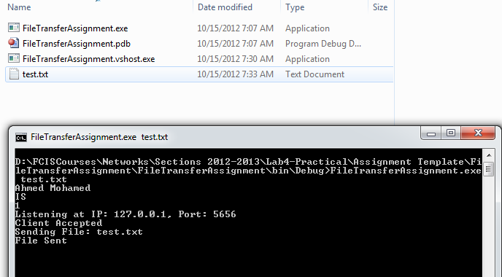
Assignment Delivery Rules
Running the exe using cmd.

